Slide 1
Systematizing Notes on Conflict Events
Cristina Mac Gregor | Gonzalo Pons | Darshan Sumant

Slide 2
Three main lines of analysis:
Prediction of agents
Relation extraction
Topic analysis

Slide 3
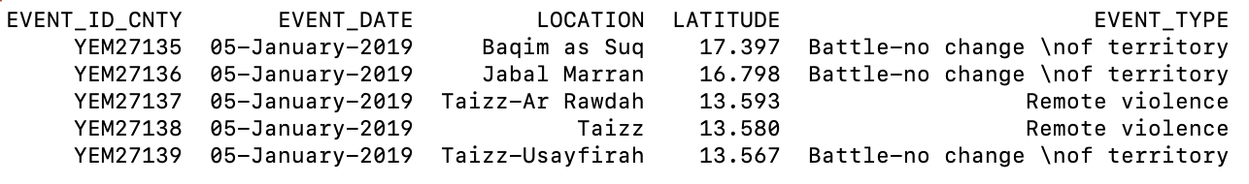
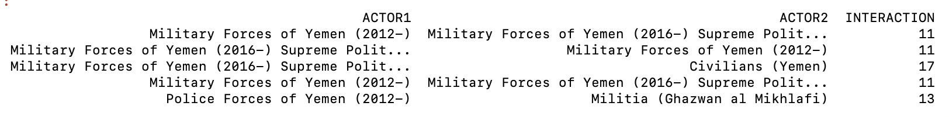
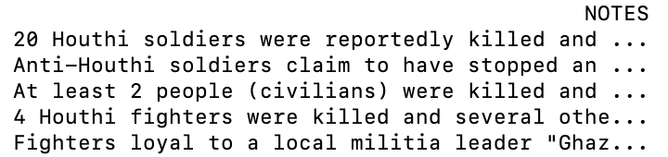
Data: ACLED - Armed Conflict Location & Event

Slide 4
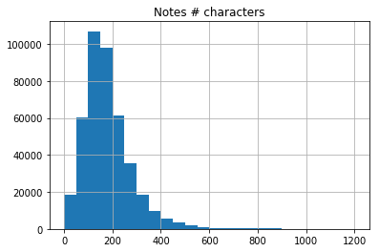
Data: ACLED - Armed Conflict Location & Event
NOTES examples:
“26th Feb 2001- BBC Mon-Large military offensive all over the country sees 9 soldiers and 6 GIA killed” (101 characters)
“A 40-year-old repentant who answered to the name of Hamid Doghman was assassinated this past Tuesday 4 March at about 2000 hours not far from downtown Zemmouri 16 kilometres east of Boumerdes by a militant group made up of between four and six elements. The attack targeted this ex-Islamist who had signed his repentance in August 1995.”
*Max = 1,708

Slide 5
GOAL 1: PREDICT ACTORS
Tokenize and vectorize the text input.
Using existing software we initialize word embeddings from the text.
Use SpaCy or Stanford NER to perform regular Name Entity Recognition and POS inputs
Split data in training, development and test. Training will be the oldest (date) 60% of news. Random split of validation/test.
Using these inputs, build a neural network to predict:
INTER1 and INTER2 OR INTERACTION.
FATALITIES
Choose best model/weights with development set.
Calculate precision, recall, and maximize Area Under Curve (AUC) measure in test set.
ACTOR1 | INTER1 | ACTOR2 | INTER2 | INTERACTION | FATALITIES | NOTES
GIA: Armed Islamic Group | Rebel Groups (2) | Military Forces of Algeria (1999-) | State Forces (1) | 12 | 1 | 26th Feb 2001- BBC Mon-Large military offensive all over the country sees 9 soldiers and 6 GIA killed
Unidentified Armed Group (Algeria) | Political Militias (3) | Civilians (Algeria) | Civilians (7) | 37 | 1 | A 40-year-old repentant who answered to the name of Hamid Doghman was assassinated this past Tuesday 4 March at ...

Slide 6

GOAL 1: PREDICT ACTORS
“26th Feb 2001- BBC Mon-Large military offensive all over the country sees 9 soldiers and 6 GIA killed”
Name Entity Recognition:
STANFORD NER
Type: ORGANIZATION, Value: BBC
Type: ORGANIZATION, Value: GIA
STACY
26th ORDINAL
BBC Mon-Large ORG
9 CARDINAL
6 CARDINAL
POS:
[(26th, 'ADJ'), (Feb, 'PROPN'), (2001-, 'PROPN'), (BBC, 'PROPN'), (Mon, 'PROPN'), (-, 'PUNCT'), (Large, 'ADJ'), (military, 'ADJ'), (offensive, 'NOUN'), (all, 'ADV'), (over, 'ADP'), (the, 'DET'), (country, 'NOUN'), (sees, 'VERB'), (9, 'NUM'), (soldiers, 'NOUN'), (and, 'CCONJ'), (6, 'NUM'), (GIA, 'PROPN'), (killed, 'VERB')]
INTERACTION :
“MILITARY VERSUS REBELS”
FATALITIES: 1

Slide 7
GOAL 2: PREDICT RELATION & DIRECTION
ACTOR 1 --- (ACTION) → ACTOR 2
ACTOR 1 ← (ACTION) --- ACTOR 2

Slide 8
GOAL 2: PREDICT RELATION & DIRECTION
ACTOR 1 --- (ACTION) → ACTOR 2
ACTOR 1 ← (ACTION) --- ACTOR 2
RNN with handcrafted features (Keith et alI):
Syntactic dependencies
Different iterations of dependency paths that include ACTOR 1 & ACTOR 2:
With length 2 and with length 3
N-gram features
Ngrams
POS windows centered on ACTOR

Slide 9
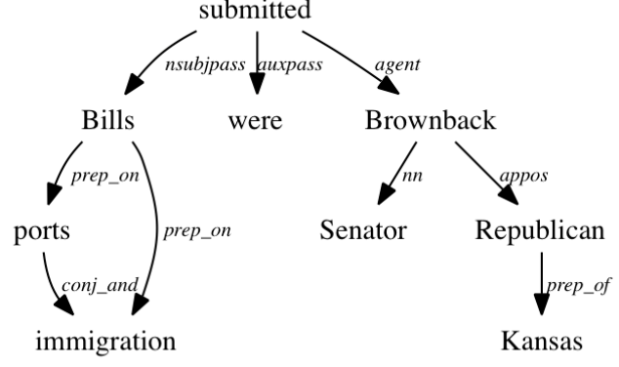
GOAL 2: PREDICT RELATION & DIRECTION
Syntactic dependencies
Different iterations of dependency paths that include ACTOR 1 & ACTOR 2:
With length 2 and with length 3

Slide 10
GOAL 2: PREDICT RELATION & DIRECTION
[177] 'Troops have shot dead a commander of Algerias most radical guerrilla faction who had been sought for scores of killings, a pro-government newspaper said. LAuthentique said Hamou Eulmi, known by his nom de guerre Zinedine, was killed Tuesday near a mos'
Troops shot guerrilla
[192] '25 March 1999 The Globe and Mail Two girls aged 2 and 3 and a woman were among nine victims who had their throats cut overnight by suspected Islamic extremists at an isolated farm south of Algiers, security services said yesterday.'
Civilians had throats cut by suspected extremists.
[1123] 'One militant was also killed Thursday in a clash with security forces in Beni Beshir, close to Skikda.'
Militant killed by security forces
[19293] 'Violent fight between Seleka rebels and rioters from the Gobongo in Bangui'[112212] 'Al Shabaab attack a military base. No reported casualties.'
Al Shabab attack to military base

Slide 11
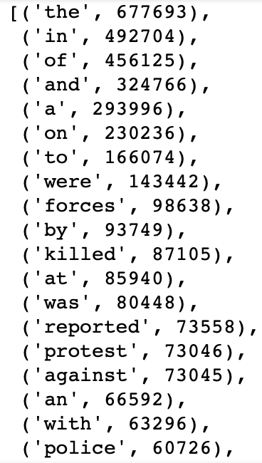
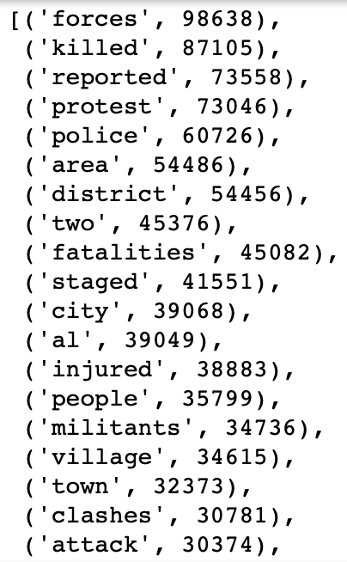
GOAL 2: PREDICT RELATION & DIRECTION
Notes:
Challenges: no labelled data.

Slide 12
GOAL 2: PREDICT RELATION & DIRECTION
Notes:
Some of the actions of interest are very common even when we’re not removing stopwords

Slide 13
GOAL 2: PREDICT RELATION & DIRECTION
Main Challenges around Extracting Relations
we’re predicting the actor1 and actor2 items. Moreover, they’re not always fully embedded in the text.
no labelled data.
given the length of the document, we can find many verbs not related to the main conflict action [reported, described]

Slide 14
GOAL 3: TOPIC ANALYSIS & FINDING PATTERNS
Existing Methodology uses an Unsupervised Approach
Doc2Vec (based on 5+ million Wikipedia articles)
Pairwise cosine similarity between all pairs of (training) documents
Min Spanning Tree (G_{S}) created for the entire dataset
Nodes are articles
Weight edges correspond to similarity between end-nodes
Markov Stability defines hard clusters based on G_{S}
There’s no way to predict what the Clusters or Topics would look like or mean!

